Slide 1
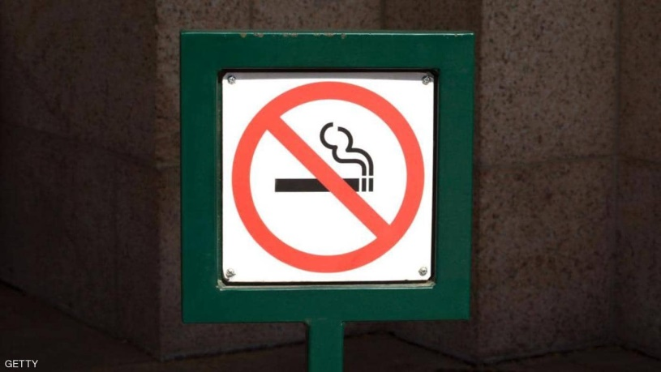
Smoking Quiz
Quitting is easy—I’ve done it a thousand times.
Mark Twain
Why you should quit today (or never start in the first place)

Slide 2
TRUE or FALSE?
According to the Centers for Disease Control and Prevention, a cigarette contains about 4000 chemicals, many of which are poisonous

Slide 3
TRUE
They include:
Nicotine: a deadly poison
Arsenic: used in rat poison
Methane: a component of rocket fuel
Ammonia: found in floor cleaner
Cadmium: used in batteries
Carbon Monoxide: part of car exhaust
Formaldehyde: used to preserve body tissue
Butane: lighter fluid
Hydrogen Cyanide: the poison used in gas chambers

Slide 4
What happens each time smoke is inhaled?
Your heart races slightly
Some air sacks in the lungs are killed, and they don’t grow back
Your blood pressure is elevated significantly
You can breathe more clearly

Slide 5
Air sacks in the lungs, called alveoli, are permanently destroyed. They are then unable to transport oxygen to the body.

Slide 6
How long can it take to become addicted to cigarettes?
About a month of daily smoking
One cigarette
You are never truly addicted. Most people can quit at any time
At least one year of regular smoking

Slide 7
Just one cigarette—for some people.
Cigarettes are just as addictive as cocaine or heroin. Even one or two cigarettes a day can put you at risk of becoming addicted.

Slide 8
Of all smokers, how many will probably die from the habit?
5%
10%
20%
30%

Slide 9
1 out of 3 – 30%

Slide 10
Why does tar build up in the lungs of smokers?
Smoke that is not exhaled deposits tar in the lungs
The combination of chemicals in a cigarette are poisonous, leaving a tar residue
That is actually a myth that has not been proven.
Smoke paralyzes cilia, which usually wave back and forth to remove foreign material

Slide 11
Smoke paralyzes cilia. The little hairlike structures cannot then sweep particles from the lungs, such as pollen, dust and other things. So the particles sit in the lungs and build up tar.

Slide 12
For help quitting, contact the American Cancer Society at 1-800-ACS-2345 or visit www.cancer.org

